Slide 1
Asynchronous Programming
javascript

Slide 2
Contents page
Asynchronous communication
Callbacks
Promises

Slide 3
Course objectives
To understand the concept of asynchronous communication.
To be familiar with JavaScript Callbacks and gain practical knowledge of working with them.
To be familiar with JavaScript Promises and gain practical knowledge of working with them.

Slide 4
Synchronous Communication
A conversation between 2 people will take this format.
One person waits whilst the other speaks.
This is synchronous communication.
Person 1
Person 2

Slide 5
Asynchronous Communication
An email conversation between 2 people would be an example of asynchronous communication
One person fires off an email, and then can continue working whilst the other party reads and responds to the email.
Either party does not wait.

Slide 6
Callbacks
Callbacks are the basic way of handling Asynchronous execution
Callbacks are founded on the functional programming paradigm, particularly Higher Order Functions
A function that has a function as an argument
Passing what you want the asynchronous operation to do after it’s done.

Slide 7
Callbacks Example
function example(callback) {
webRequest(); //pretend method
callback();
}
function log() {
console.log("Done");
}
example(log);//Execution
//Opposed to
webRequest();
console.log("Done");
Example – Making a web request to the website, however we have to wait for the response, if we paused execution until that happened it’s just wasted execution time, we could do other things while we wait by using it in an async way

Slide 8
Callback activities
Write the example on the previous slide into a JavaScript file.
Execute this file to see how it responds.

Slide 9
Promises
Real-World example
A Promise can have 3 states
Pending
Fulfilled
Rejected

Slide 10
Promises Cont.
A promise is a value that represents something that will happen – it is a proxy value
We can then call methods on this promise and say:
When this thing happens
Then do something else
The JavaScript function .then() can be used, it returns a promise itself which allows them to be chained together.
A Promise will either resolved or rejected, it will return something or throw an error.

Slide 11
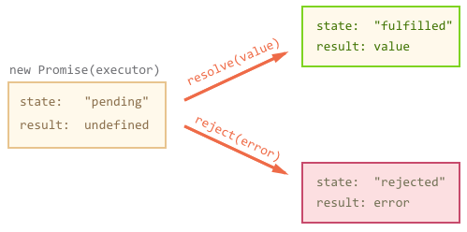
PROMISE

Slide 12
Creating a promise
const aCondition = true;
const createPromise = new Promise(
function (resolve, reject) {
if (aCondition) {
const user = {
name: 'Bert',
email: 'bert@gmail.com'
};
resolve(user);
} else {
const reason = new Error('Rejected');
reject(reason);
}
}
);
Notes:
https://scotch.io/tutorials/javascript-promises-for-dummies

Slide 13
Consuming a promise
const consumePromise = function () {
createPromise
.then((user) => {
console.log(user);
})
.catch(function (error) {
console.log(error.message);
});
};
consumePromise();

Slide 14
Promise Practice activities
Write the examples on the previous slides into a JavaScript file.
Execute this file to see how it responds.

Slide 15
Summary
To understand the concept of asynchronous communication.
Asynchronous communication is like communication via email, one party can continue working whilst the other works on a response.
To be familiar with JavaScript Callbacks and gain practical knowledge of working with them.
We have worked with sample Callbacks and should be able to work more complicated Callbacks in the future.
To be familiar with JavaScript Promises and gain practical knowledge of working with them.
We have worked with sample Promises and should be able to work more complicated Callbacks in the future.

